Slide 1
vision based human activity recognition
Allah Bux, Plamen Angelov and Zulfiqar Habib

Slide 2
abstract:
this review paper provides a comprehensive state-of-art survey of defferent phase of Human activity recognition
Techniques related to segmentation of the image into physical objects. feature extraction and activity classification .

Slide 3
segmentation： point, line, edge, boundary...
object segmentation is a basic HAR process. it is to extract the required object from the sequence of images(or called video).
challenges and issues in segmentation:
noisy image: image may be of poor quality due to image source or image compression
camera jitter:when camera sways back and forth due to wind, it causes nominal in the sequence. in this case whthout robust and false detection cannot be avoided.
camera automatic adjustment:due to automatic adjustment feature of modern cameras such as auto focus, auto brightness, auto white balancing. this may affect the colour level adjustment between different frames.
illumination changes: due to sudden changes of illumination in an indoor or outdoor scene, the false detection of foreground mask can occur in several parts of the image.

Slide 4
segmentaion:
segmentation of the image into physical objects
background construction-based segmentation
foreground extraction-based segmentation
basic models
statistical models
fuzzy models
neural network based models
others
optical flow
markov random fields
temporal information

Slide 5
feature extraction and representations
global feature
DFT/DCT
SIFT
SURF
HOG
NWFE
SHAPE-BASED
feature extraction and representations
local feature
semantic feature
pose-based
appearance-based

Slide 6
classification
activity recognition and classification
k-nearest neighbour
dynamic time wraping(DTW)
hidden markov models(HMMs)
classification models
support vector machine(SVM)
artifical neural network
multi-dimensional indexing
deep learning

Slide 7
background construction-based segmentation I
background construction based segmentation :
the background model is first constrcted and then object is identified from the successive video frames using background subtraction method. in fact, the background subtracion is achieved by differencing the current frame and the background. the type of segmention is effective for tacking fast moving objects from the video captured by static cameras(fixed, the background static, illumination is constant.).
three steps of background subtraction method :
backgound initialization: it is the background models,(the model can be design in different ways . statistical, fuzzy,neural network technique).often, the model is initialized by the first frame of video .but it is quite chanllenging to get first background model .
background maintenance:the step is aimed at updating the background model with respect to the changes which occur in the scene.
foregound detection:this step is the subtraction from background and foreground pixel .we will get an object pixel when background subtracted.

Slide 8
segmentation: II
BASIC MODELS: stationary camera. usually ,the background is also stationary then any change in the scene is consider as moving foreground objects.different basic models were proposed for background subtraction of simple background. basic background substarction models are simple and computationally less expensive, these method can not handle more realistic multimodal and complex background.
one of the simple ways to develope a background model is to build an average model of the scene, substract each video frame from it , and threshold the result .
another important is using discriminative texture features for background modelling and a modified version of the local binary pattern(LBP)operator for feature extraction.
multi-layer background substraction method is an extension of the discriminative texture feature.use LBP and photometric invariant colour measurement in RGB colour sapce . conbining the advantages of both texture and colour features.
based on combination of local colour, intensity, and texture features using Double Local Binary pattern (DLBP)operator for feature extraction.
a score board algorithm for estimationg stationary background. recording the intensity variations of pixel the samll variations were assigned positive scores, and large variations were negative score.
a background modelling method based on a subpixel edge map , using a Gaussian mixture model (GMM) the method is suitable for detecting foreground objects with cluttered background and handling illumination changes.

Slide 9
segmentation: III
statistical models:
a single Gaussian per pixel model was used for real time tracking of people and interpreting their behaviour, the system reports good result in an indoor scene but there have been no report for its success in outdoor scenes. this is the first algorithem that handled motion blur.
statistical method often use GMM(gaussian mixture model),these models offer several advantages.
1.they can effectively handle multimodal background,
2.they are adaptive,different thresholdselected for each pixel is adaptived in time
3. these are parametric models and parameters are updated adaptively without keeping large buffer of frames in the memory.
several limitations:
1.these models cannot effectively handle sudden changes in the scene and drastic lighting changes.
2.these methods require many parameters that should be selected appropriately and areuser and problem specific
3. appropriate initialization of the Gussian is also an issue that needs to be handled

Slide 10
segmentation: IV
FUZZY MODELS: fuzzy logic based method are used in different step of the background substraction process. different models such as (sugeno fuzzy integral(积分) for aggregrating（合集） the colour and texture feature, the objects were detecting by thresholding the result, choquet intergral for foreground detecting)
they offer several advantages as compare to statistical models , firstly, these moehods are useful for modeling uncertainties in dynamic background. secondly, these methods are more robust to shadow detection and illumination changes.thirdly these mothods are also helpful in background maintenance in case of shadow and illumination chages .
there are some drawbacks of fuzzy logic based methods firstly the threshold value is estimated by train and error, which increase the detection time. secondly, the moving objects with the same gray level as their background are not detected accurately.

Slide 11
segmentation: V
neural notwork based mothos:
in this class of models each pixel of the sequence is classified either as a foreground or background using artificial neural networks . the background is automatically generated by self-organization method with prior knowledge regarding involved patterns.
advantage: these method can handle light changes, moving backgrounds camouflage, and bootstrapping problems
limitaions: over-fitting problem which may affect the accuracy of results.

Slide 12
other models
eigen space（特征空间） model : eigen space model background method for segmentation was employed due to its lower computation complexity.
non-parameter background subtraction models: it is based on estimation of probality distribution which is a probabilistic way to define a background model

Slide 13
foreground extraction -based segmentation
in foreground extraction based segmentation , videos are capture by the moving camera , hence the background , foreground, camera all move . so the object segmentation in these scenarios is very challenging as compared to the static camera， the background and foreground motion was mixed
in the foreground extraction based segmentation , temporal information , spatial information or spatio-temporal information is utilized for getting the initial object from video， and then objects in the following frames are determined using change information motion information or any other feature-based information.
Optical flow based methods: it depends upon the distribution of movements of bright patterns in an image. optical folw method is employed for feature matching in two consecutive frames ,these feature are classified as foreground or background using multiple view geometry.moving objects can be detecting and segmentation by analysing the trajectories of some key point. there are limitations of the type methods: these methods need to calculate dense optical flow over long time frames, which is time consumeing. an optical flow method relies on point trajectories computed through optical flow with focus on those areas of the image where optical flow woks best
optical flow based method are computataionally complex and are used for complex dynamic image analysis.

Slide 14
Markov random fields(MRFs) based method
A Markov Random Field (MRF) is a graphical model of a joint probability distribution
MRFs are used to model the foreground field and enhance the spatial and temporal continuity of the moving objects. this method is based on the colour information and region merging.joint random fields (JRFs) is an extension to the MRF model . a region-matching-based method for object detection and tracking by moving cameras.
the method has higher computational cost and might not be effective for real time application

Slide 15
feature extraction and representation
once the objects are segmentation from the background , these are representation in the form of feature such as shape, silhoutee, colour, motion features.
global features consider image as a whole, while local feature operate on a pixel level ,
semantic-based features represent high level action of the human body such as pose, poselet, attributes.and are more human intelligible.
the overall performance of the activity recognition systems mianly depends on the proper feature extraction and representation mechanism.

Slide 16
global feature
global feature refers to the overall attribute of an image , common global feature include colour feature, texture feature, and shape feature,such as intensity histogram.it is a low level visual feature at the pixel level .and the global feature has good invariance ,simple computation, intuitive representation. but high demension and large computation are its fatal weakness. in addition, the global feature description is not suitable for image aliasing and occlusion .
DFT/DCT(discrete Fourier transform)/(discrete Cosine(余弦) Transform)
DFT has been employed in many image processing and conputer vision applications DFT represent the intensity variation of an image.it transform an image the spatial domain to frequency domain.

Slide 17
local feature
Local features are features extracted from local areas of images, including edges, corners, lines, curves and areas with special attributes.Common local features include two types of description: corner and region.local image features have many features in the image, small correlation between features, and will not affect the detection and matching of other features.In recent years, local image features have been widely used in face recognition, 3D reconstruction, target recognition and tracking, film and television production, panoramic image Mosaic and other fields.A good local image feature should have features such as high repetition rate of feature detection, fast speed, robustness of feature description to image transformation such as illumination, rotation and viewpoint change, low dimension of feature descriptor, and easy to realize fast matching.

Slide 18
local feature models
SIFT(scale invariant feature transform)
SURF (SURF descriptor)
HOG(histograms of oriented gradients)
NWFE(nonparametric weighted)
Shape-based features

Slide 19
semantic based feature
post estimation
appearance(外观 外貌) based
语义特征提取部分:首先选取一类物体的若干图片作为训练库，提取所有图片的SIFT特征点；通过k-均值聚类算法对所有SIFT特征点进行空间聚类，然后利用基于核函数的决策机制，决策出每个空间类别内的若干有效点；利用支持向量机分类器训练每个空间类别内的有效点，每个空间类别训练出一个具有语义特征的视觉单词，便最终提取出可描述一类物体语义特征的视觉词汇表；选取多类物体的训练图片，提取每类物体的视觉词汇表,形成多类物体的视觉词汇表

Slide 20
activity recognition and classification
after feature later from a suquence of image(video),next step is to select the suitable classification algorithm for activity recognition.
we will have an classes set, through training of feature.

Slide 21
K-nearst neighbour(KNN)
the KNN algorithm is a classification methond based on a pre-defined constant K, a point is classified to a class which is most frequent among K nearst training points. the KNN algorithm is suitable for multi-modal activities and the decision of the classification is based on the neighbourhood of objects.
the model is simple, it needs few parameters for turning its performance is based on the selection of K.
test time is not dependent on the number of classes.
it is robust with respect to the search space

Slide 22
dynamic time wrapping (DTW)动态时间规整
dynamic time warping (DTW) is one of the algorithms for measuring similarity between two temporal sequences, which may vary in speed .DTW has been applied to temporal sequences of video, audio, and graphics data — indeed, any data that can be turned into a linear sequence can be analyzed with DTW. In general, DTW is a method that calculates an optimal match between two given sequences

Slide 23
hidden markov models
Hidden Markov Model (HMM) is a statistical Markov model in which the system being modeled is assumed to be a Markov process – call it X – with unobservable ("hidden") states. HMM assumes that there is another process Y whose behavior "depends" on X. The goal is to learn about X by observing Y.
Hidden Markov models are known for their applications to thermodynamics, statistical mechanics, physics, chemistry, economics, finance, signal processing, information theory, pattern recognition - such as speech, handwriting, gesture recognition, part-of-speech tagging, musical score following, partial discharges and bioinformatics

Slide 24
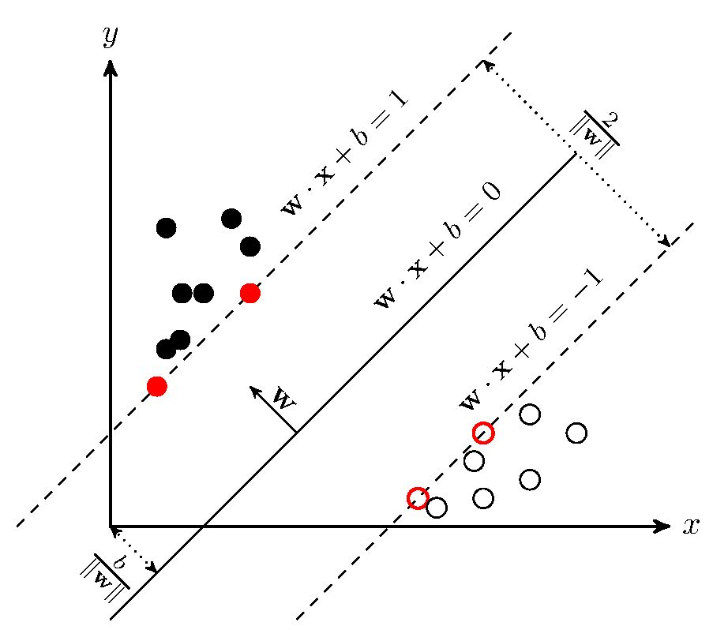
support vector machine
In machine learning, support-vector machines (SVMs, also support-vector networks) are supervised learning models with associated learning algorithms that analyze data for classification and regression analysis.
支持向量机（support vector machines, SVM）是一种二分类模型，它的基本模型是定义在特征空间上的间隔最大的线性分类器，间隔最大使它有别于感知机；SVM还包括核技巧，这使它成为实质上的非线性分类器。SVM的的学习策略就是间隔最大化，可形式化为一个求解凸二次规划的问题，也等价于正则化的合页损失函数的最小化问题。SVM的的学习算法就是求解凸二次规划的最优化算法

Slide 25
kalman filter
卡尔曼滤波（Kalman filter）是一种高效率的递归滤波器（自回归滤波器），它能够从一系列的不完全及包含噪声的测量中，估计动态系统的状态。卡尔曼滤波会根据各测量量在不同时间下的值，考虑各时间下的联合分布，再产生对未知变数的估计，因此会比只以单一测量量为基础的估计方式要准。
In statistics and control theory, Kalman filtering, also known as linear quadratic estimation (LQE), is an algorithm that uses a series of measurements observed over time, containing statistical noise and other inaccuracies, and produces estimates of unknown variables that tend to be more accurate than those based on a single measurement alone, by estimating a joint probability distribution over the variables for each timeframe. The filter is named after Rudolf E. Kálmán, one of the primary developers of its theory.

Slide 26
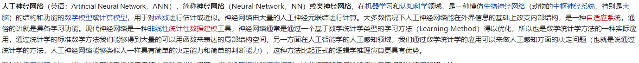
artificial nerual network(ANN)
Artificial neural networks (ANNs), usually simply called neural networks (NNs), are computing systems vaguely inspired by the biological neural networks that constitute animal brains.
An ANN is based on a collection of connected units or nodes called artificial neurons, which loosely model the neurons in a biological brain. Each connection, like the synapses in a biological brain, can transmit a signal to other neurons. An artificial neuron that receives a signal then processes it and can signal neurons connected to it. The "signal" at a connection is a real number, and the output of each neuron is computed by some non-linear function of the sum of its inputs. The connections are called edges. Neurons and edges typically have a weight that adjusts as learning proceeds. The weight increases or decreases the strength of the signal at a connection. Neurons may have a threshold such that a signal is sent only if the aggregate signal crosses that threshold. Typically, neurons are aggregated into layers. Different layers may perform different transformations on their inputs. Signals travel from the first layer (the input layer), to the last layer (the output layer), possibly after traversing the layers multiple times.

Slide 27
multi-dimensional indexing
multi-dimensional indexing has used for human activity classfication such as
the activity was representation by major human poses and velocity of major body parts such as hands, legs, and torso. this information was stored as a set of multidimensional hash tables. activity recognition was achieved by indexing and sequencing of few pose vectors in the hash tables.

Slide 28
deep learning
Deep learning (also known as deep structured learning) is part of a broader family of machine learning methods based on artificial neural networks with representation learning. Learning can be supervised, semi-supervised or unsupervised.
Deep-learning architectures such as deep neural networks, deep belief networks, recurrent neural networks and convolutional neural networks have been applied to fields including computer vision, machine vision, speech recognition, natural language processing, audio recognition, social network filtering, machine translation, bioinformatics, drug design, medical image analysis, material inspection and board game programs, where they have produced results comparable to and in some cases surpassing human expert performance

